Slide 1

IAM
Permissions Explorer
By Aryan Singh

Slide 2
Introduction
IAM (Identity and Access Management) allows organizations to securely manage access to cloud resources by assigning permissions based on user roles and responsibilities.
It follows two key principles:
Need-to-Know: Users should only have access to the specific resources required for their job.
Least Privilege: Users should be granted the minimum level of permissions necessary to complete their tasks.
For example, if a user works with S3 storage, they should only have access to relevant S3 bucket operations—not full administrative access across the cloud environment.

Slide 3
IAM Permissions Explorer – Feature Overview & Rationale
The IAM Permissions Explorer is designed to help security engineers and cloud administrators identify, analyze, and remediate excessive or unused permissions across cloud environments. The solution focuses on simplifying complex IAM data into actionable insights while following the principle of least privilege.
Features
Success Metrics
1. Centralized IAM Dashboard
4. Actionable Remediation Panel
The effectiveness of the solution can be measured using:
Provides a unified view of all users, roles, and permissions. It highlights key metrics such as high-risk users, unused permissions, and total access distribution to enable quick monitoring.
Allows users to take quick actions such as:
Removing unused permissions
Downgrading access levels
Marking permissions as safe
This reduces the time required to fix security issues.
Reduction in high-risk permissions (%)
Time taken to identify and resolve IAM issues
Number of unused permissions removed
User engagement with remediation actions
Improvement in overall security posture score
2. Risk Scoring System
5. Smart Filters & Search
Each user and permission is assigned a risk score based on:
Access level (Admin, Write, Read)
Inactivity (last used)
Number of permissions
This helps prioritize which users or roles require immediate attention.
Enables filtering by role, risk level, and activity to quickly locate problematic users or permissions.
Prioritization
3. Detailed User Permission View
P1 (High Priority): Dashboard visibility, risk scoring, user-level analysis
P2 (Medium Priority): Filtering and search functionality
P3 (Low Priority): Automated recommendations and advanced insights
The focus is first on visibility and clarity, followed by efficiency and automation
A deep-dive screen showing:
Permission breakdown by service (e.g., S3, IAM, RDS)
Last accessed data
Risk contribution factors
This improves visibility and helps in precise decision-making.

Slide 4
Problems
In large cloud environments, IAM roles often become overly permissive due to poor visibility and lack of monitoring. Over time:
Users accumulate unnecessary permissions
Roles are rarely audited
Unused access remains active
This increases the risk of :
Security breaches
Misuse of critical resources
Compliance issues
Security engineers currently lack a simple and intuitive way to:
Identify excessive permissions
Detect unused access
Take quick corrective actions

Slide 5
User Persona
Cloud Security Engineer / DevOps Engineer
Goals:
Pain Points:
01
02
Ensure secure access control
Reduce permission risks
Audit IAM roles efficiently
Too many roles and policies
Hard to track unused permissions
No clear suggestions for fixing issues
SUMMARY:
“Designing a system that helps security engineers quickly identify, analyze, and fix excessive IAM permissions using
the principles of least privilege.”

Slide 6
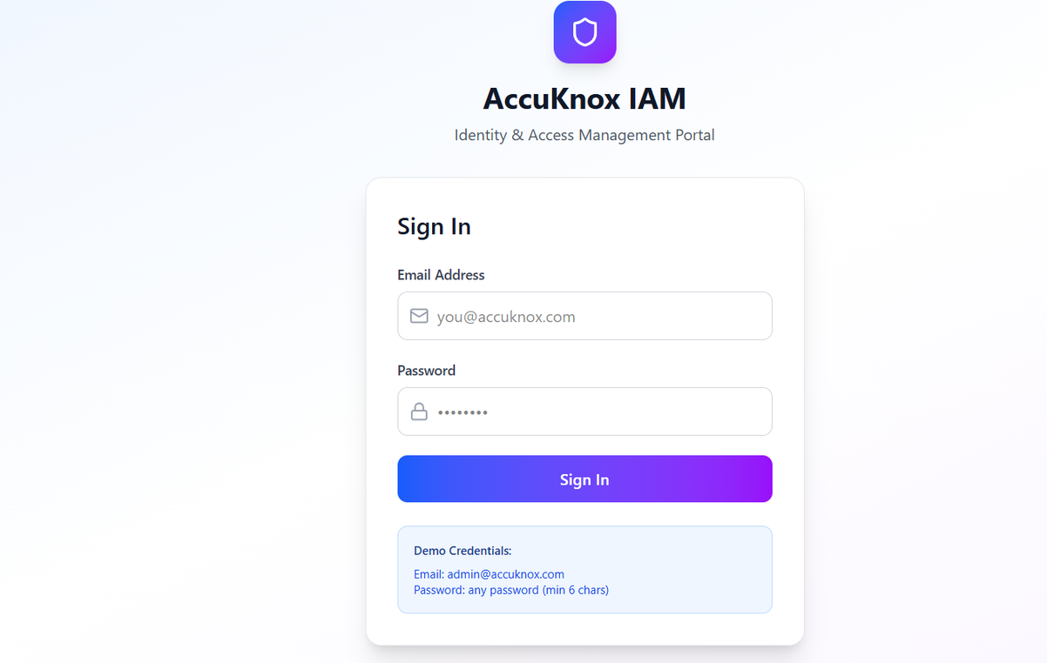
FIGMA
Login page
The login page ensures that only authorized users can access the IAM dashboard. Since the system manages sensitive cloud permissions, allowing open access would be insecure.
Purpose:
Restrict access to verified users
Protect IAM data and cloud resources
“Security starts at entry — without authentication, the dashboard would be exposed and unsafe.”

Slide 7
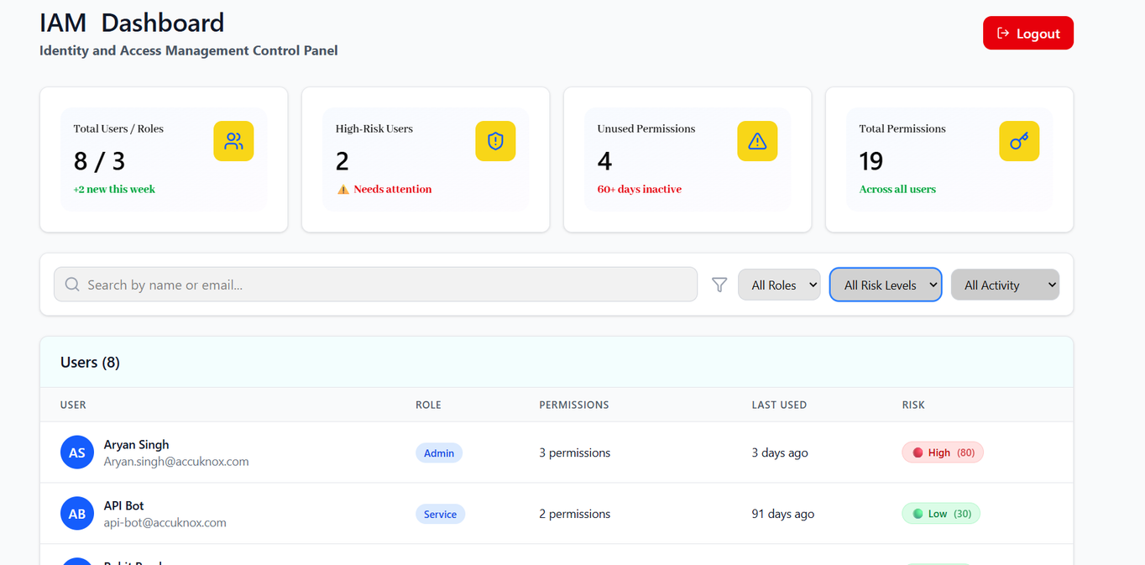
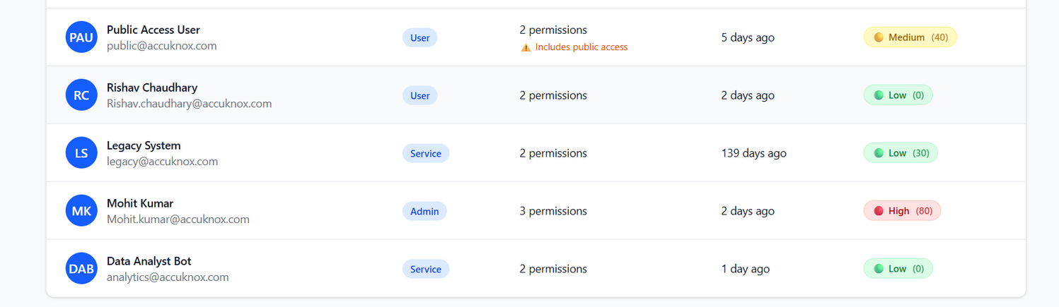
IAM Dashboard – Permission Visibility & Risk Overview
The dashboard provides a centralized view of all users, roles, and permissions, helping security engineers quickly identify risks and take action.
Purpose:
Monitor IAM activities and permission usage
Identify high-risk users and unused permissions
Enable quick filtering and analysis
Key Elements:
Summary cards (Total Users, High-Risk Users, Unused Permissions)
Search and filters (role, risk level, activity)
User table with role, permissions, last used, and risk score
Risk indicators (High, Medium, Low) for quick decisions

Slide 8
Calculating Risk:
Risk Calculation Logic:
Risk score is calculated based on key IAM factors like access level, usage, and permission spread.
Risk Formula:
Risk Score = Access Level + Inactivity + Permission Count
Factors Used
Number of Permissions
01
Access Level
03
Admin access → +50
Write access → +30
Read-only → +10
Many permissions (>10) → +20
Moderate (5–10) → +10
Few (<5) → +5
Last Used (Inactivity)
02
Final Risk Levels
04
Not used for 90+ days → +30
Not used for 30–90 days → +20
Recently used → +5
Admin user (+50)
Not used for 90 days (+30)
Has 12 permissions (+20)

Slide 9
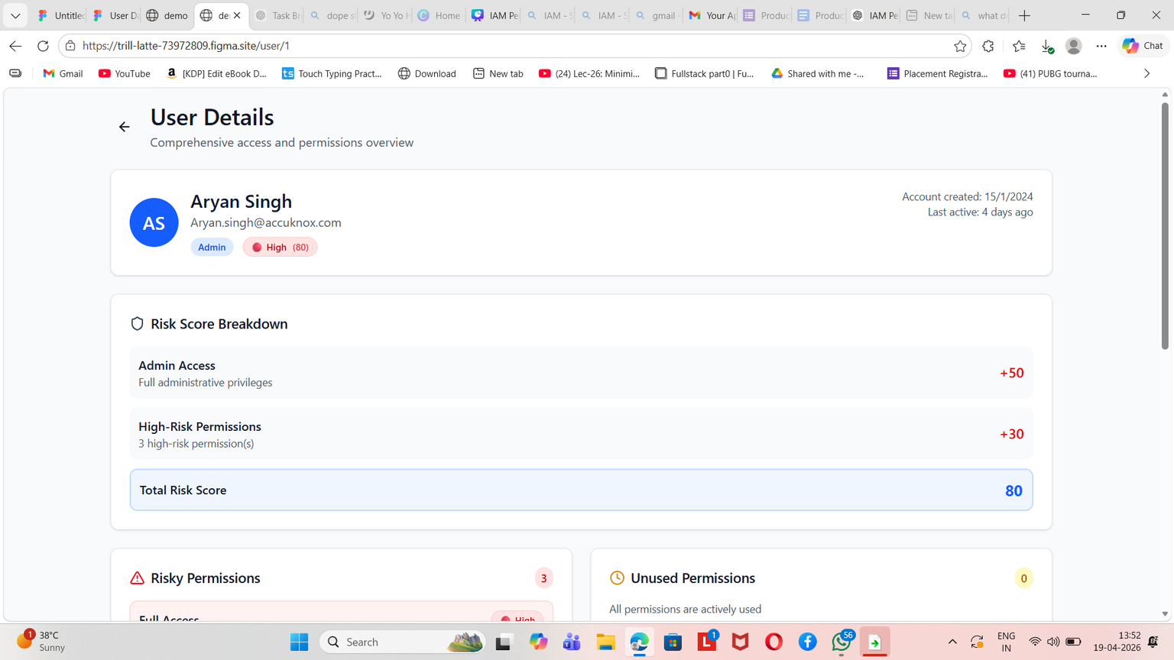
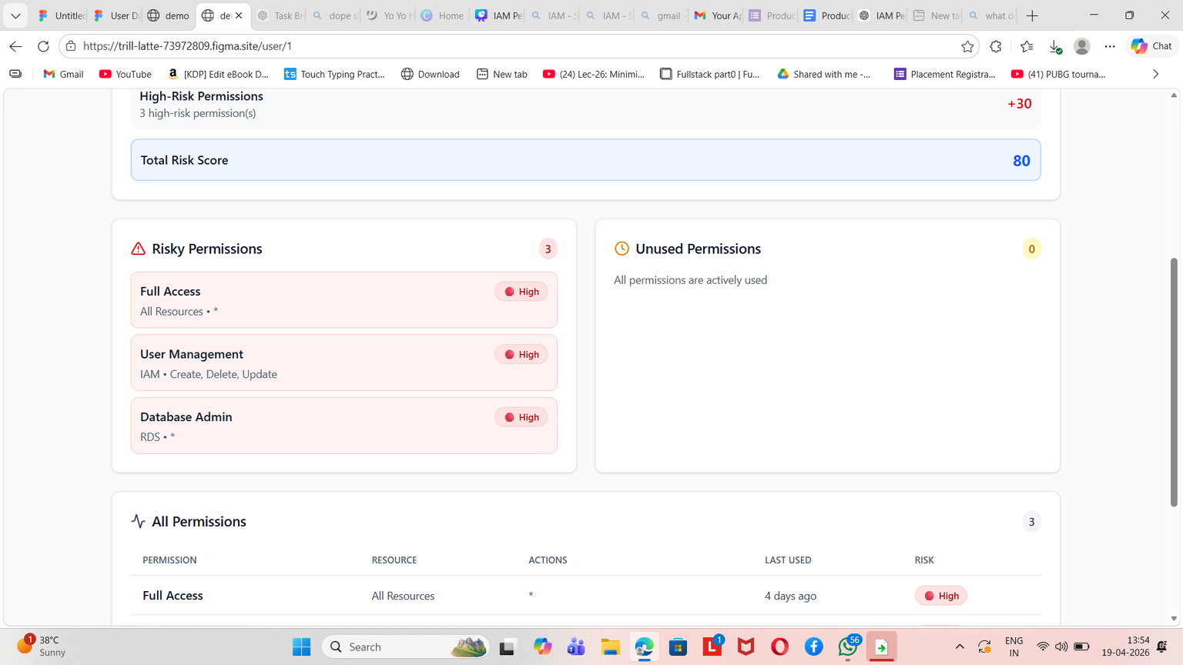
User Detail Page – Deep Permission Insights & Actions
This screen gives a comprehensive view of an individual user’s access, helping security engineers understand why a user is risky and how to fix it.
Purpose:
Break down user-level risk clearly
Highlight over-permissioned access
Enable quick and safe remediation
Key Elements:
User Summary: Role, last activity, overall risk score
Risk Score Breakdown: Shows factors (e.g., admin access, high-risk permissions) contributing to total risk
Risky Permissions: Clearly highlighted for immediate attention
Unused Permissions: Identifies unnecessary access
Permissions Table: Includes resource, actions, last used, and risk level

Slide 10
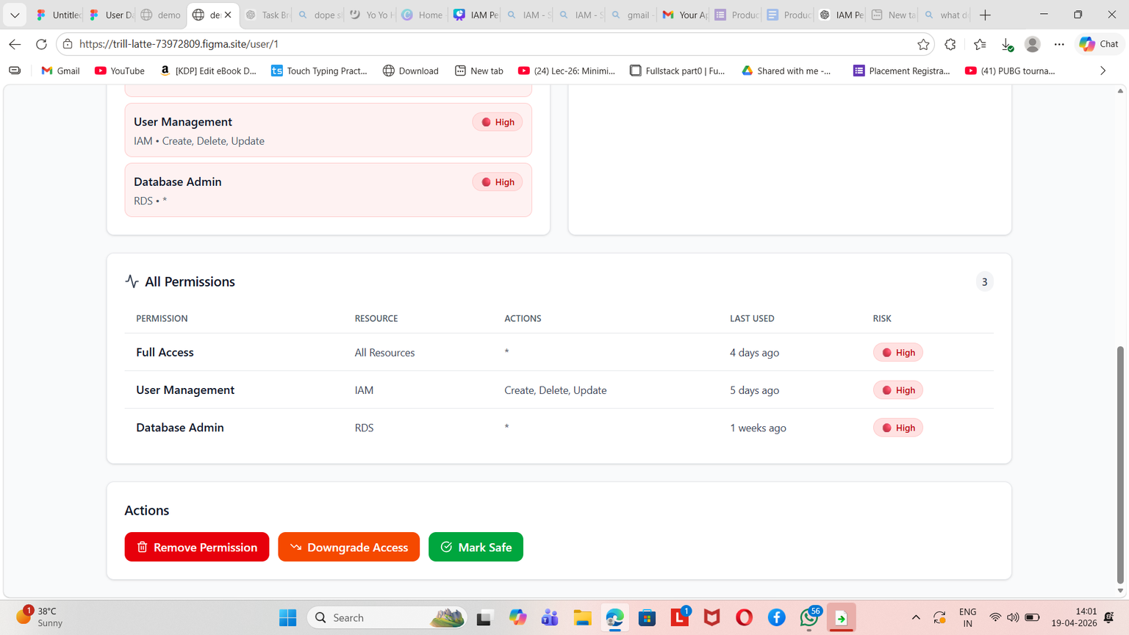
Action Panel:
Remove Permission
Downgrade Access
Mark Safe
This screen not only identifies security issues but also explains and resolves them in one place, reducing investigation time and improving cloud security.

Slide 11
(Bonus/Optional Task) Identify development action items that can be discussed with the development team :
1. IAM Data Integration
5. Remediation Actions
Integrate with cloud provider APIs (AWS/GCP/Azure)
Fetch users, roles, policies, and permission data
Sync data periodically (real-time or scheduled)
Secure execution of actions like:
Removing permissions
Updating roles/policies
Add confirmation and rollback mechanisms
2. Permission Usage Tracking
6. UI Performance & Scalability
Capture “last used” data for each permission
Maintain logs for access activity
Handle cases where usage data is missing or delayed
Handle large IAM datasets efficiently
Implement pagination, lazy loading, and filtering
Optimize table rendering
3. Risk Scoring Engine
7. Security & Access Control
Implement logic for risk calculation (access level, inactivity, permission count)
Allow configurable weights for flexibility
Ensure fast calculation for large datasets
Ensure only authorized users can access IAM data
Role-based access for this tool itself
Secure API endpoints and authentication
4. Backend APIs
APIs for dashboard data (users, roles, risk scores)
APIs for user detail view and permission breakdown
APIs for performing actions (remove, downgrade, mark safe

Slide 12
Thank You !
by Aryan Singh

